Slide 1
Land Evaluation for
changes in Land Use
Immediate and useful service
Land Use Sustainability Assessment (LUSA)
using the data that exists
Processessing steps
Identify Threats and their Indicators
Rank indicators according to ease of obtaining data
Arrive at a six-fold land use capability classification
Results with three degrees of confidence:
<C (1) – where, C is land use capability class,
and 1 is degree of confidence in data source
Threat Identification and Management (TIM) concept
Land Use Sustainability Assessment
design management packages (by the district/sub-district staff)
to combat the threats/hazards to the sustainability of the desired
land use OR recommend an alternative land use

Slide 2
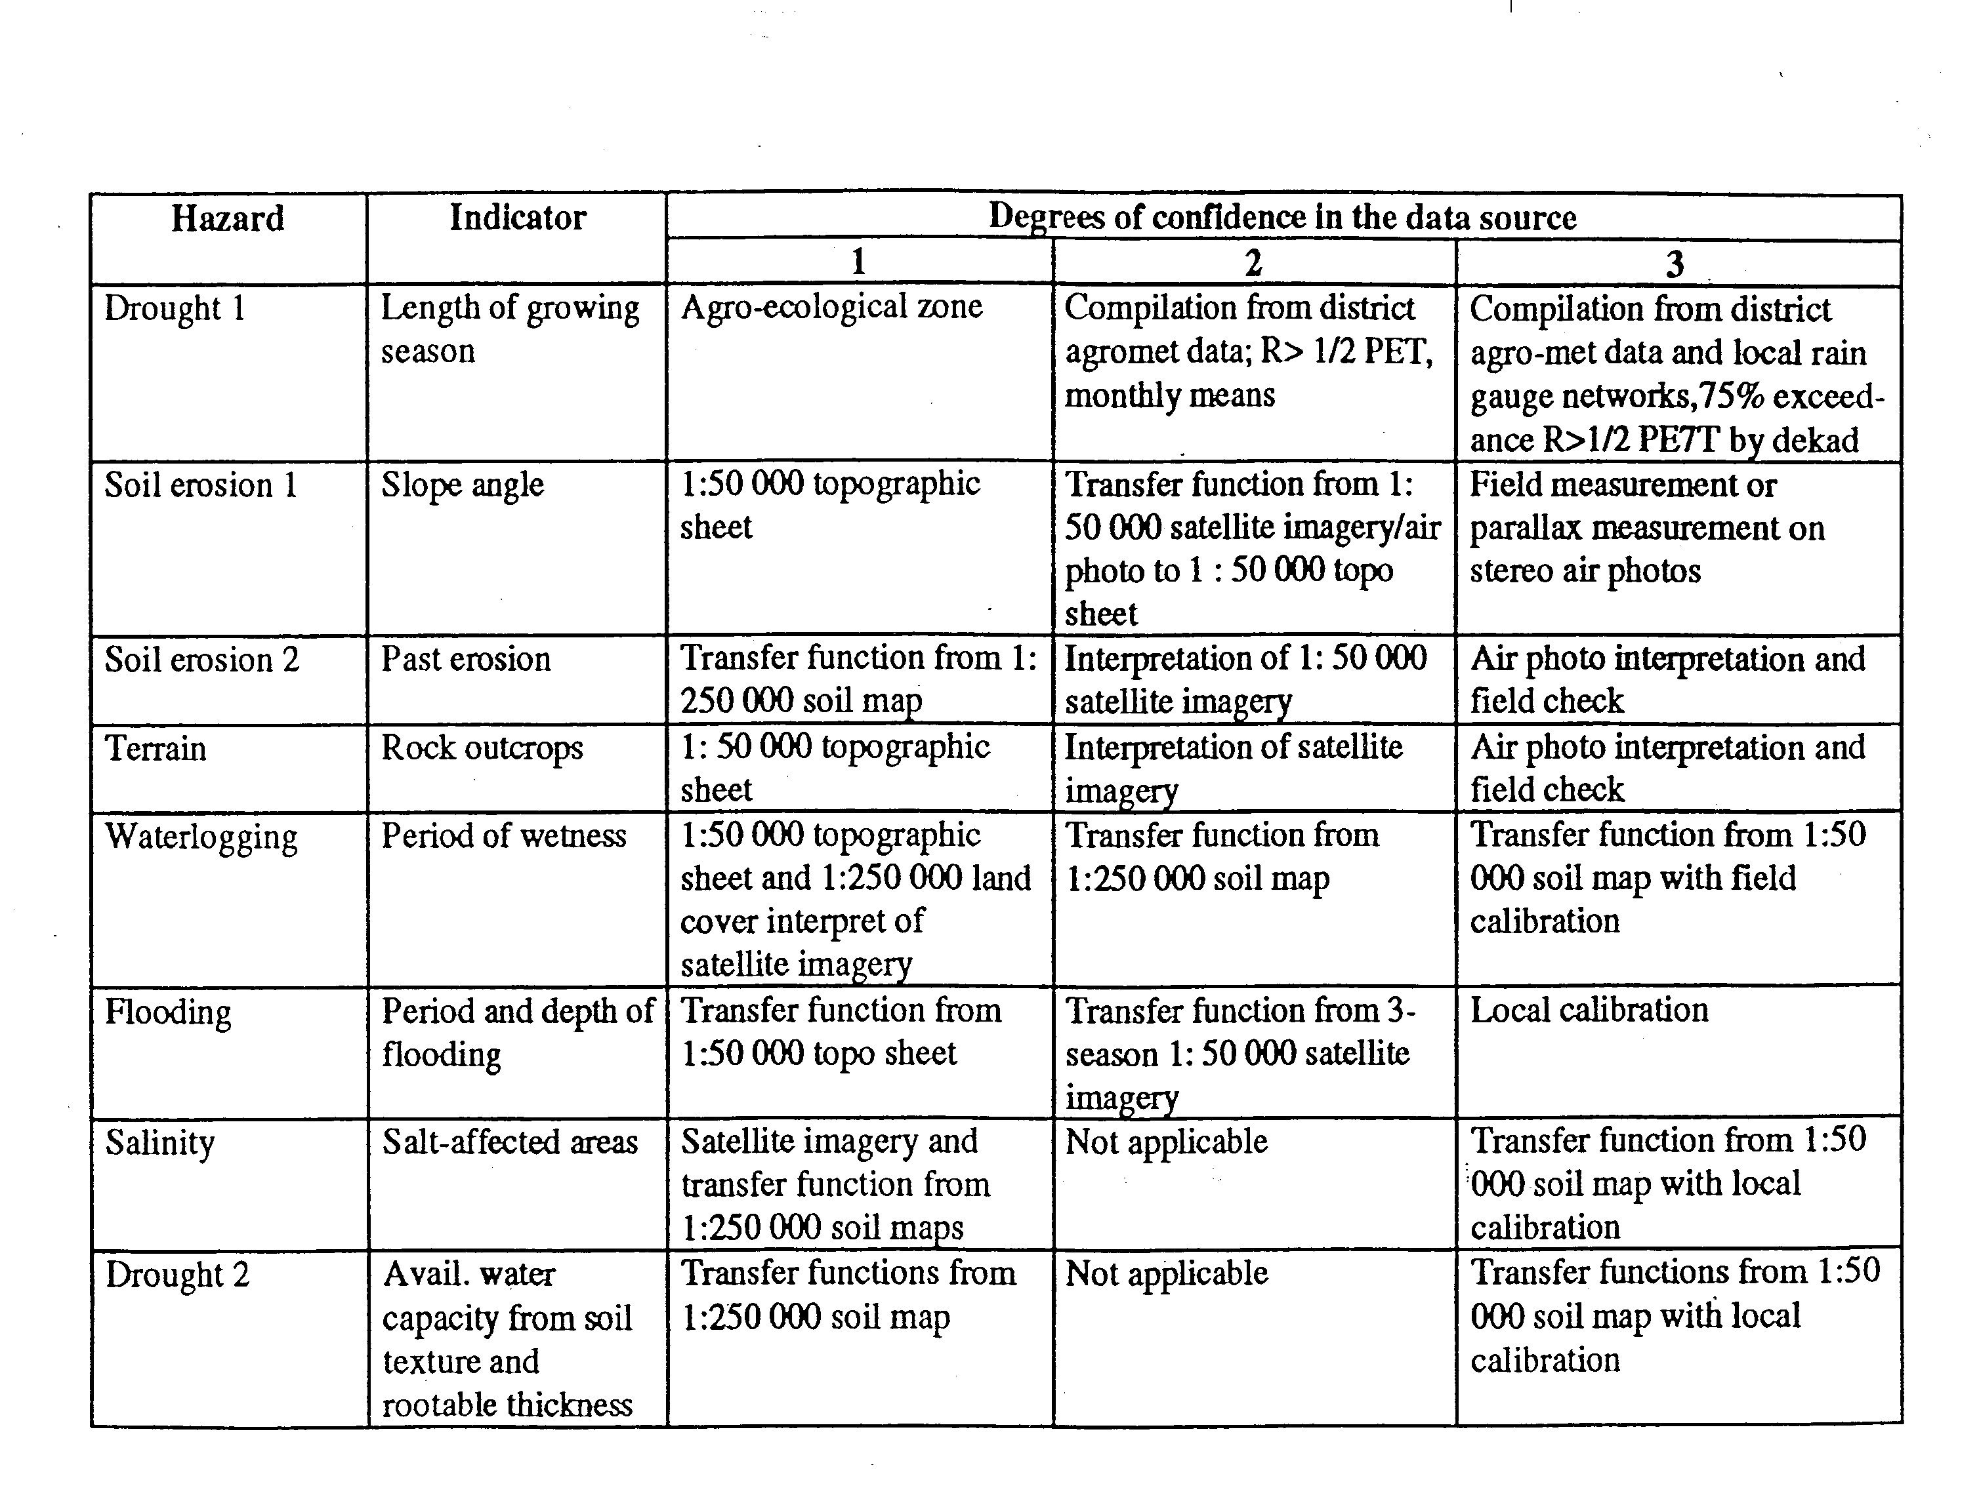
Degree of Confidence in Source Data
in data source
/ limitation

Slide 3
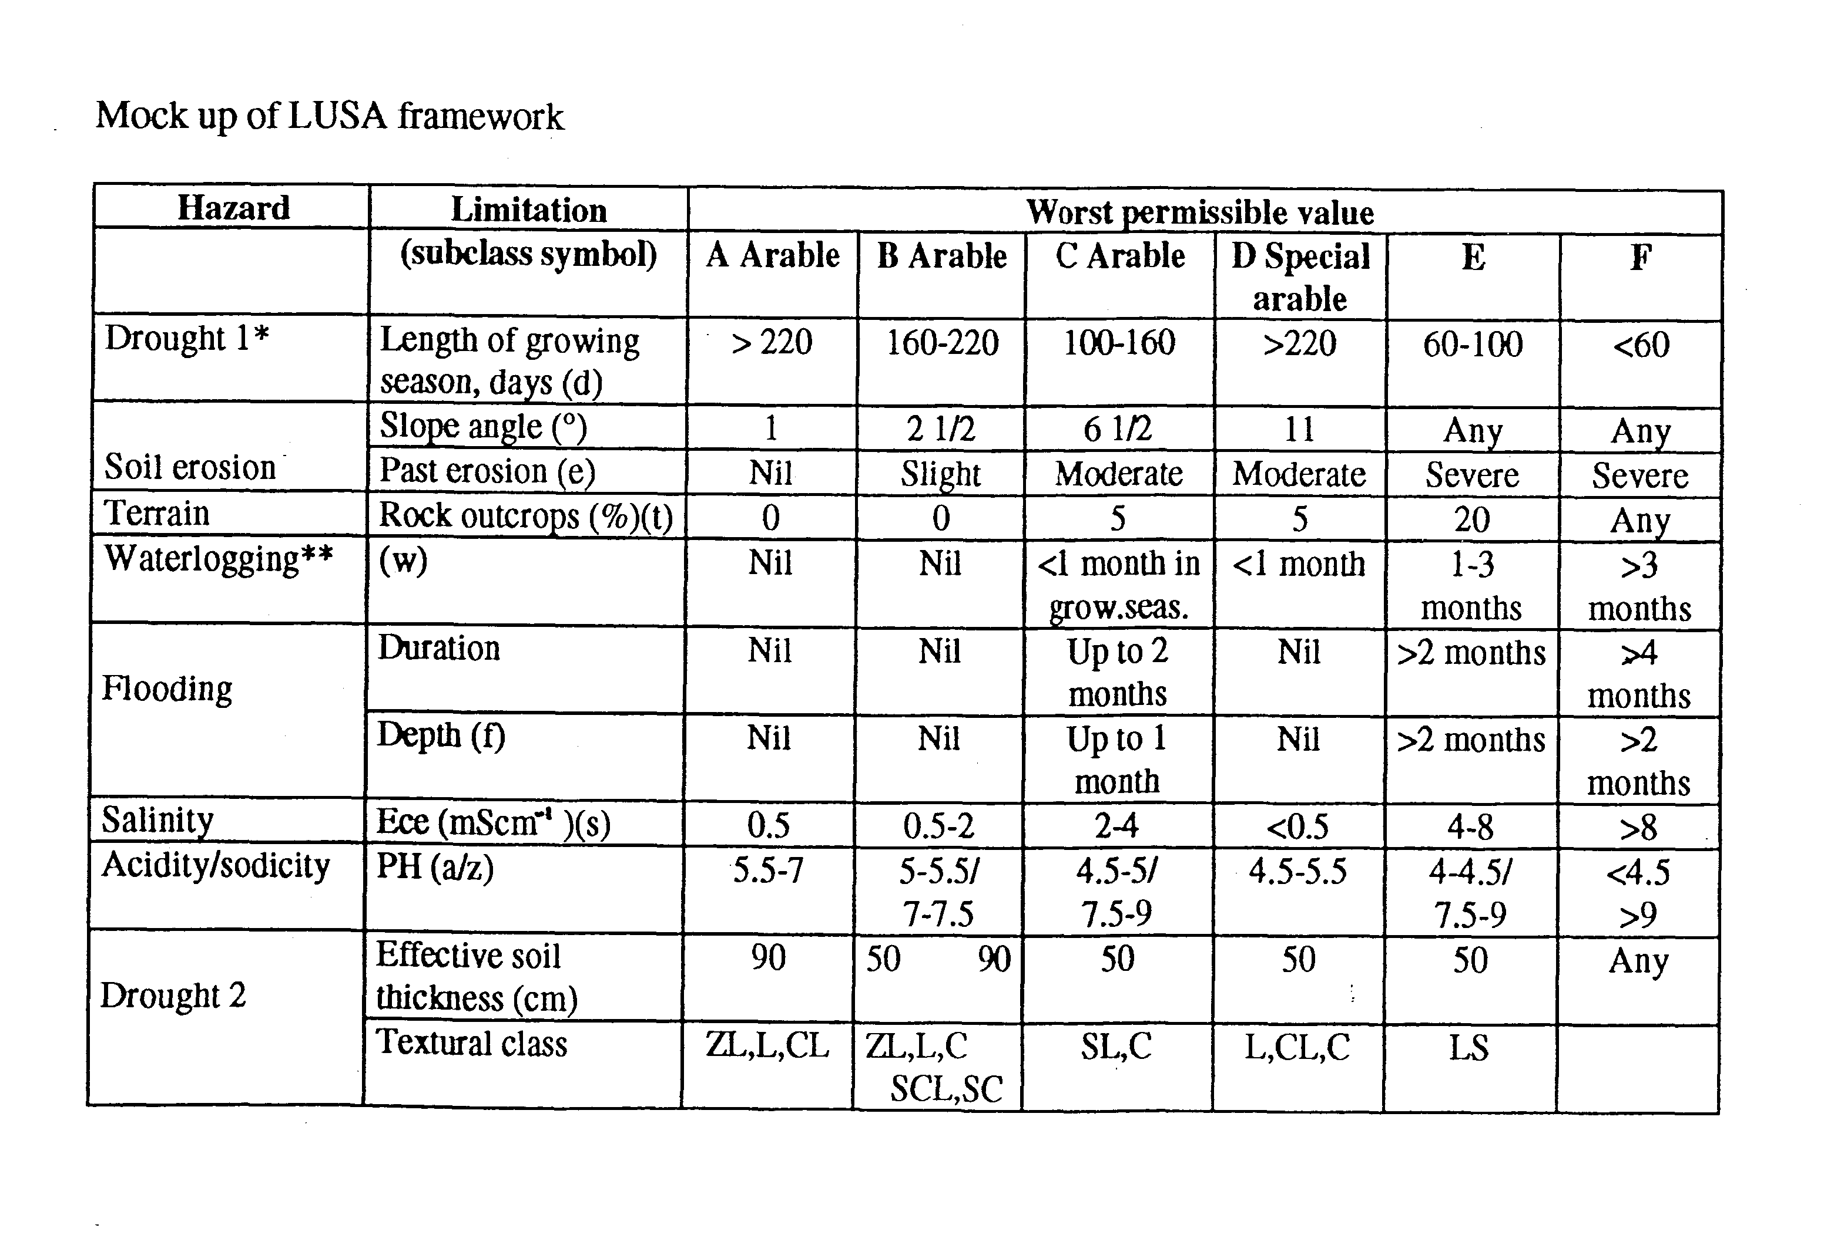
in data source
Procedure to allocate the land class to a particular patch of land
The procedure has been programmed to successfully de-rate any parcel of land under consideration according to severity of limitation
Subtractive Approach (Shaxson, 1981)
Start at the top left corner with the first limiting factor, length of growing season. Scan horizontally to locate the appropriate limiting value, say growing season is 250 days, stay in Column A. Now move down to second limitation slope, so that if the slope in question is 2°, stop in the second column. The land class cannot be better than B-Arable.
Now move down to the third limitation, past erosion¸, which might be assessed as ‘nil’. This favorable characteristic does not improve the capability class; slope remains limiting.
Now move down to the fourth limitation, wetness, which might be assessed as ‘wet for short periods during the growing season’. Scan horizontally to find the appropriate degree of limitation, which is in the third column so the capability class cannot be better than C.
Continue stepwise downwards, considering each limiting factor in turn. The final classification is determined by the single most limiting factor. The sub class may denote the more limiting factors, say C (wet for short periods)

